Slide 1

Identification and Prediction of Money Laundering Activities Using Big Data Analytics
P Raga Amrutha Ratna – 2320030355
R Bramhani – 2320030104
G Sheetal – 2320030092
Sec – 4
Guide Name – K Venkateswara Rao

Slide 2
Introduction & Motivation
Problem Statement:
Financial institutions generate massive transaction data daily.
Detecting money laundering patterns manually is difficult.
Traditional systems struggle with large-scale, complex financial data.
Motivation:
Increase in financial fraud and illicit transactions.
Need for automated, scalable fraud detection systems.
Big Data + Machine Learning can improve detection accuracy.
Real-World Relevance Supports banks and regulatory bodies.
Helps reduce financial crime risks.
Enhances trust in digital financial systems.

Slide 3
Objectives
Project Goals:
Analyze large-scale financial transaction datasets.
Identify suspicious transaction patterns.
Predict high-risk transactions and accounts.
Expected Outcomes:
Efficient Big Data processing pipeline.
ML model capable of fraud prediction.
Improved detection of potential money laundering behavior.

Slide 4
Literature Survey
Existing Solutions:
Rule-based Anti-Money Laundering (AML) systems.
Statistical anomaly detection techniques.
Machine learning-based fraud detection approaches.
Limitations / Research Gaps:
Poor scalability for big transaction datasets.
High false positives in rule-based systems.
Limited integration of Big Data frameworks with ML.
Research Gap Identified:
Need for scalable AML systems combining distributed processing with predictive ML models.

Slide 5
Proposed Methodology
Approach:
Collect public and synthetic financial transaction datasets.
Preprocess and clean data.
Perform distributed processing using Apache Spark.
Extract features (amount, frequency, time intervals, sender/receiver).
Train Machine Learning models for prediction.
Evaluate model performance.
Technologies / Tools:
Apache Spark
Big Data ecosystem
Machine Learning algorithms
Python / PySpark
Visualization tools

Slide 6
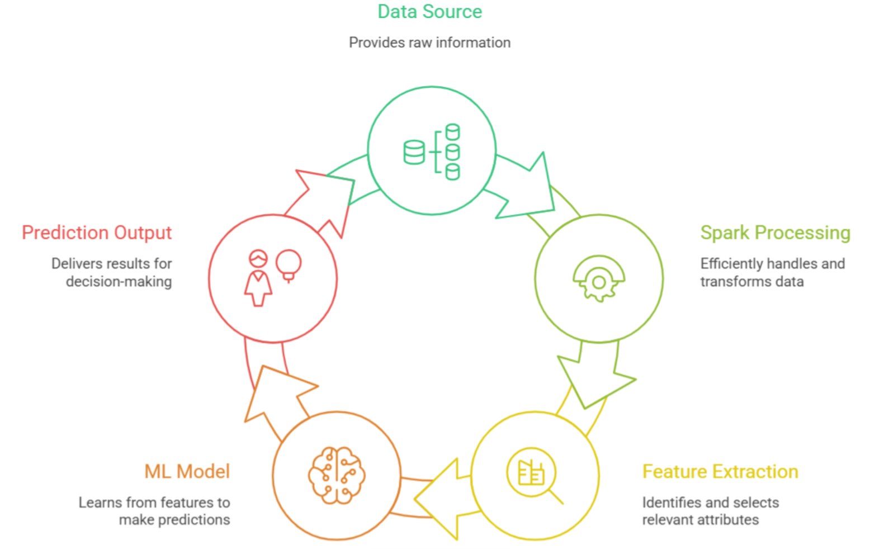
System Architecture

Slide 7
Technologies & Tools Used
Languages: Scala, SQL (HiveQL)
Big Data: Hadoop, HDFS, Hive, Spark
ML: Spark MLlib (Logistic Regression)
Processing: Data Cleaning, Feature Engineering, Sampling
Tools: Hortonworks HDP, Zeppelin, Ambari
Platform: VirtualBox, Linux
Data Transfer: HDFS Commands, SCP
Dataset: Synthetic Financial Transaction Data (Fraud Labels)

Slide 8
Expected Results & Deliverables
Expected Results:
Identification of suspicious transaction patterns.
Prediction of high-risk accounts.
Scalable AML detection framework.
Deliverables Big Data processing pipeline.
Trained ML model.
Performance evaluation report.

Slide 9
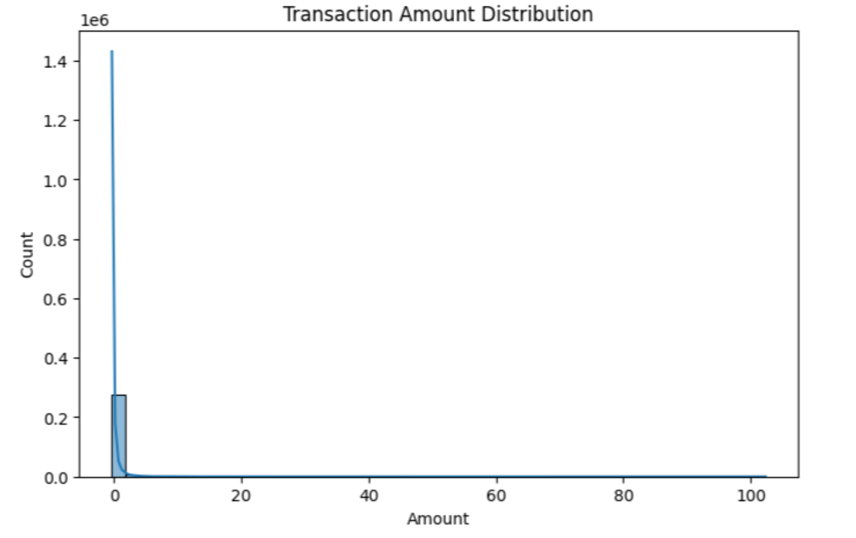
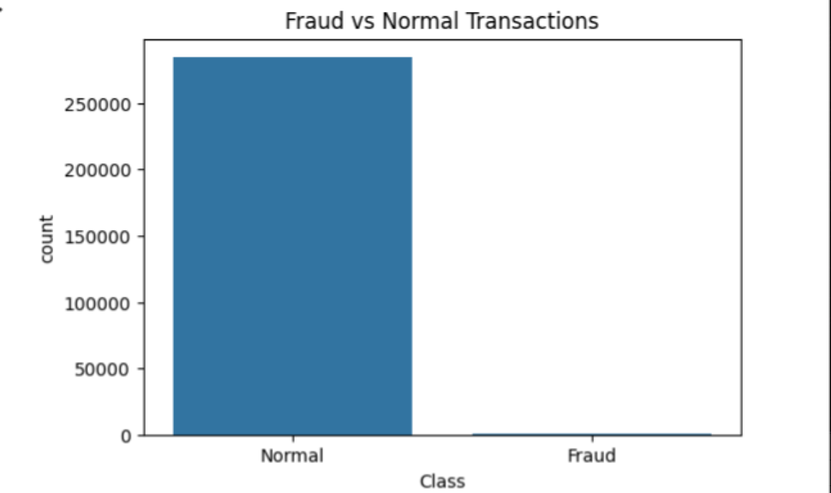
Output:

Slide 10
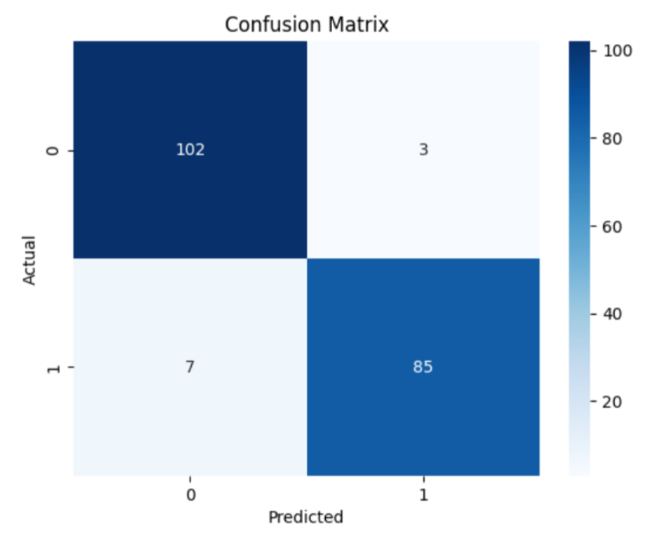
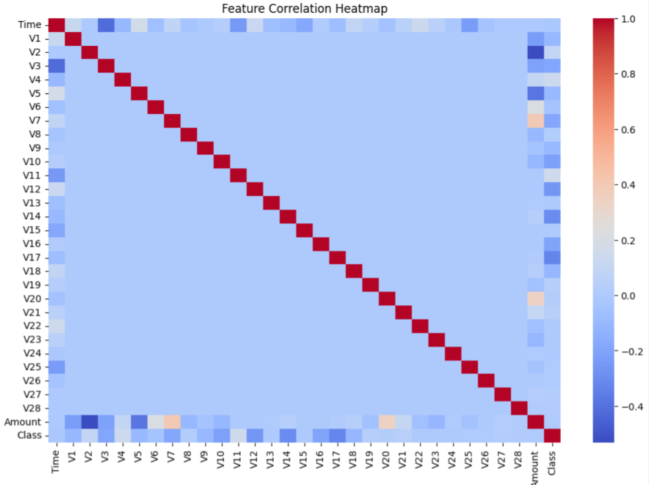

Slide 11
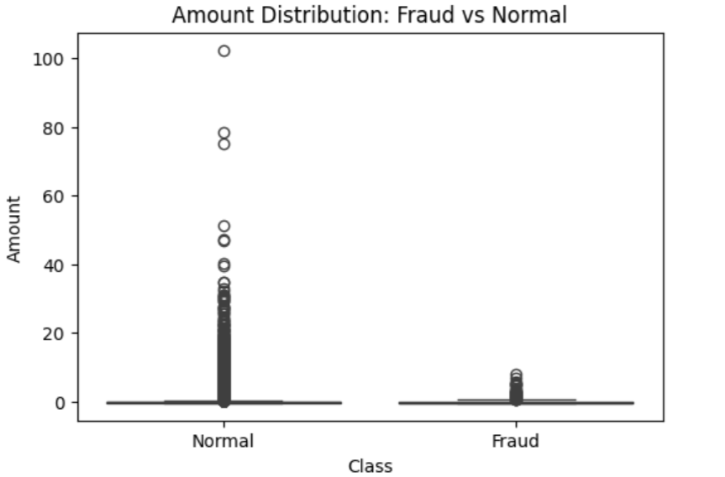
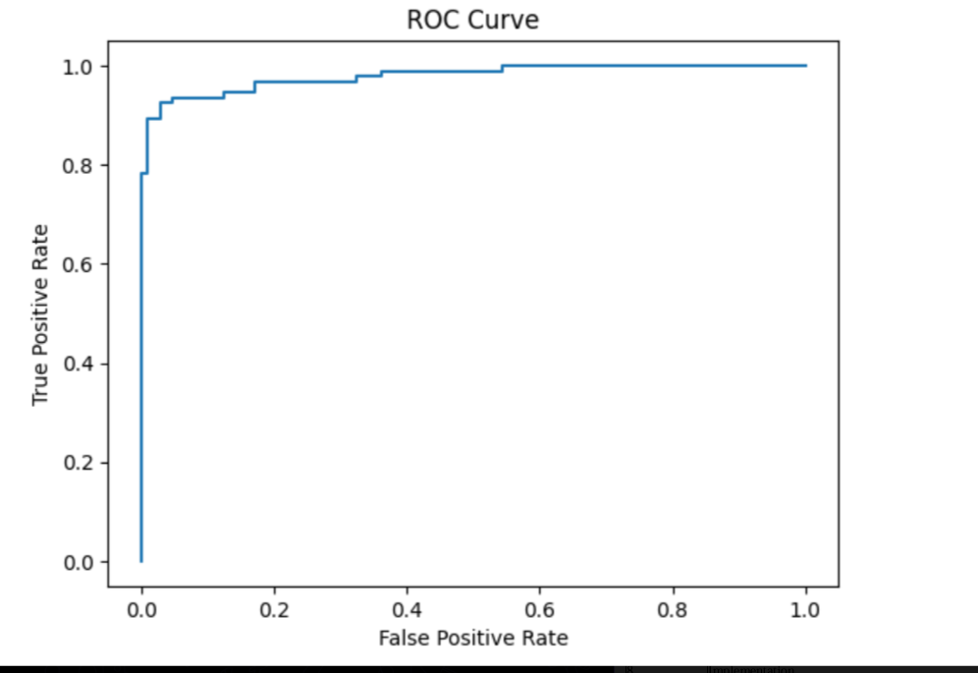

Slide 12
References
Financial Fraud Detection using Machine Learning – IEEE https://ijaseit.insightsociety.org/index.php/ijaseit/article/view/13160?utm
Big Data Analytics in Banking – Springer https://www.researchgate.net/publication/393329480_Machine_Learning_for_Fraud_Detection_in_Financial_Transactions?utm
Anti-Money Laundering Detection using Data Mining – Elsevier https://www.researchgate.net/publication/388724525_Financial_Fraud_Detection_For_Credit_Card_Transactions_using_Apache_Spark
Apache Spark for Financial Analytics – ACM https://www.ijset.in/wp-content/uploads/IJSET_V13_issue6_144.pdf?utm
Machine Learning for Fraud Detection – IEEE Access https://www.mdpi.com/2076-3417/12/19/9637?utm
Big Data Applications in Banking Security – Wiley https://arxiv.org/abs/2503.10058?utm

Slide 13
Thank You

